Slide 1
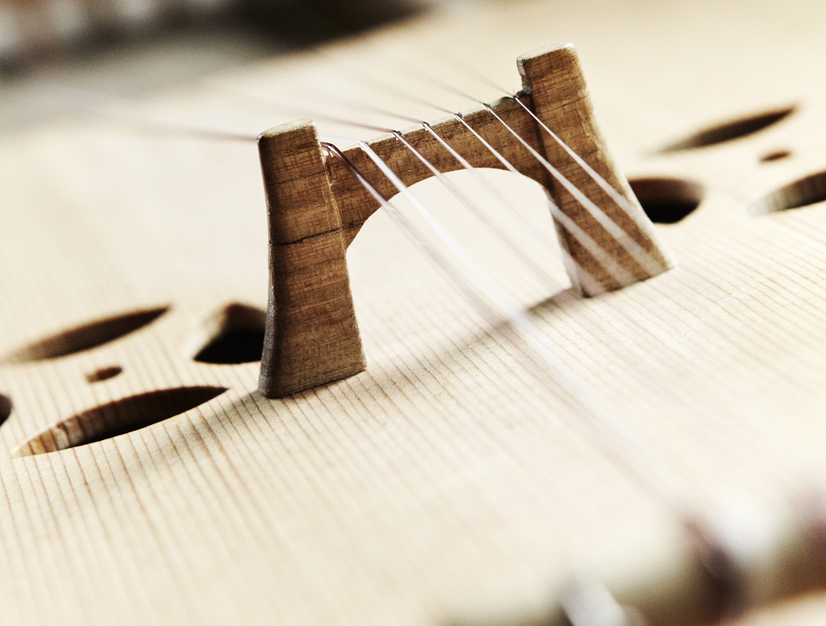
FORSIDE MED FOTOGRAFI

Slide 2
FolkOrg
The Norwegian National Association for Traditional Music and Dance.
Founded in 1923

Slide 3
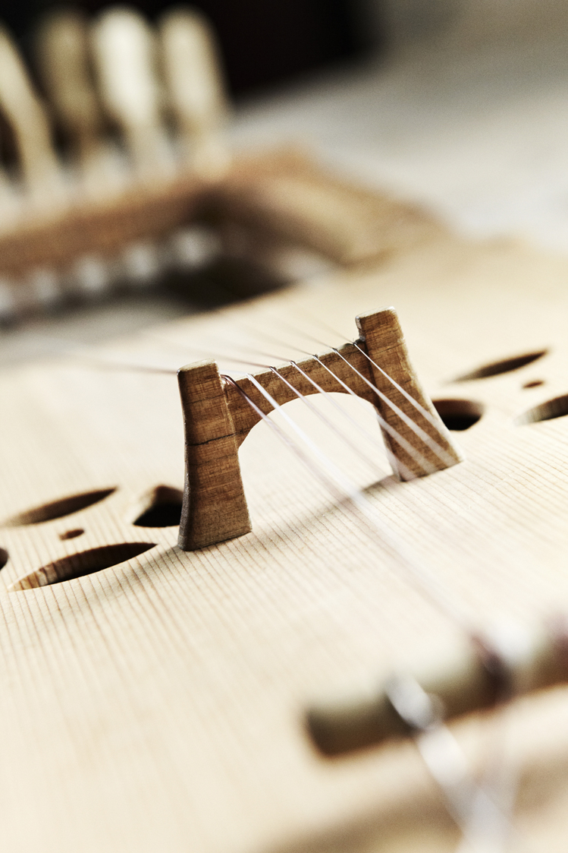
ABOUT FOLKORG
• 4300 members
• 149 local fiddle societies / folk dance societies
• 10 regional folk societies
• A network of concert organizers and festivals

Slide 4
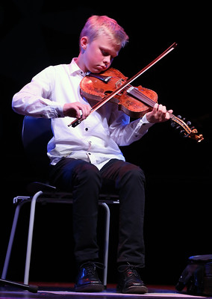
OUR MAIN EVENTS
• Norwegian Traditional Music and Dance Competition (Landskappleiken)- Since 1896.

Slide 5
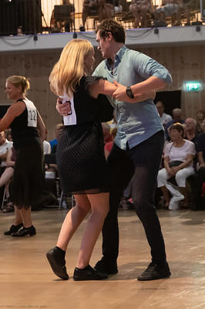
OUR MAIN EVENTS
• Norwegian Festival of Old-Time Dance Music (Landsfestivalen i gammaldansmusikk)

Slide 6
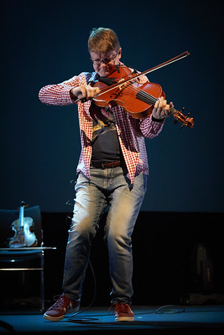
OUR MAIN EVENTS
• Folkelarm
• A Nordic industry convention for traditional music and dance.

Slide 7
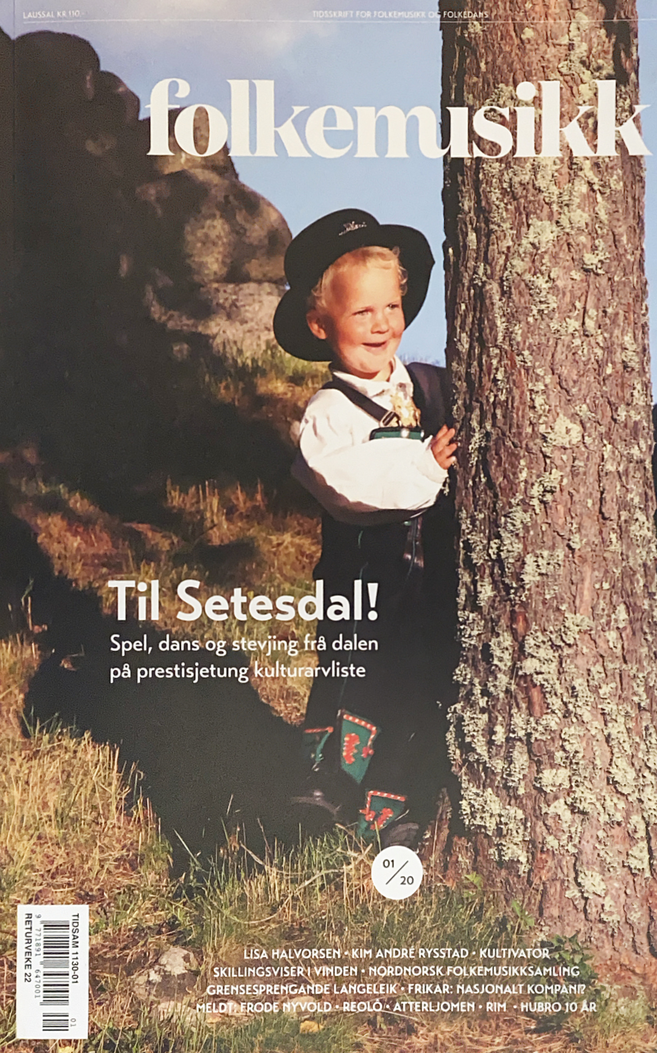
OTHER TASKS
• The magazine Folkemusikk
• PR and information
• Recruiting projects
• International networking
• Political lobbying.

Slide 8
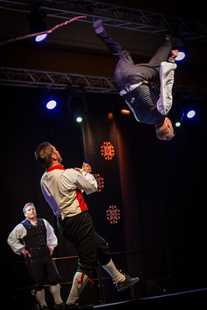
WHAT CAN EFN DO FOR US?
• Information about relevant concert organizers and festivals in Europe.
• Network of interesting people that can be invited to Folkelarm
• To exchange experiences.
• Musicians and dancers can meet and work together.
• Fiddle and dance societies can meet their equivalents in Europe.

Slide 9
WHAT CAN FOLKORG DO FOR EFN?
• Be an active part of the networking and exchange of experience
• Use our long history of being an association.
• Help with information about musicians, dancers, festivals and concert organizers.
• Host an EFN meeting at Folkelarm

