Slide 1

Fédération des Acteurs et Actrices des Musiques et Danses Traditionnelles
The federation of the agents of folk music and dance
Notes:
Fédération des Acteurs et Actrices des Musiques et Danses Traditionnelles

Slide 2
INTRODUCTION TO THE FAMDT
A federation representing a diversity of structures in the field of folk music and dance, limited profit and non-profit structures, created in 1985.
148 members from the whole ecosystem (Collective of artists, teaching places, concert venues and festivals, stage and record producers, documentation centres, research laboratories (ethnopoles),...), bringing together thousands of structural agents from the whole national territory in various fields: live performance, documentation, transmission, amateur practice...
It federates a dynamic and current field of folk cultures, which have the feature of being part of art and social practice, heritage and creation.
A collective and pragmatic "research and development" tool to support the challenges and consolidate the sector of folk music and dance
A cooperative space for shared services, support and experimentation
A place of shared analysis, for thinking, to debate and work in a collective way, to network, to enhance practices and support members.

Slide 3
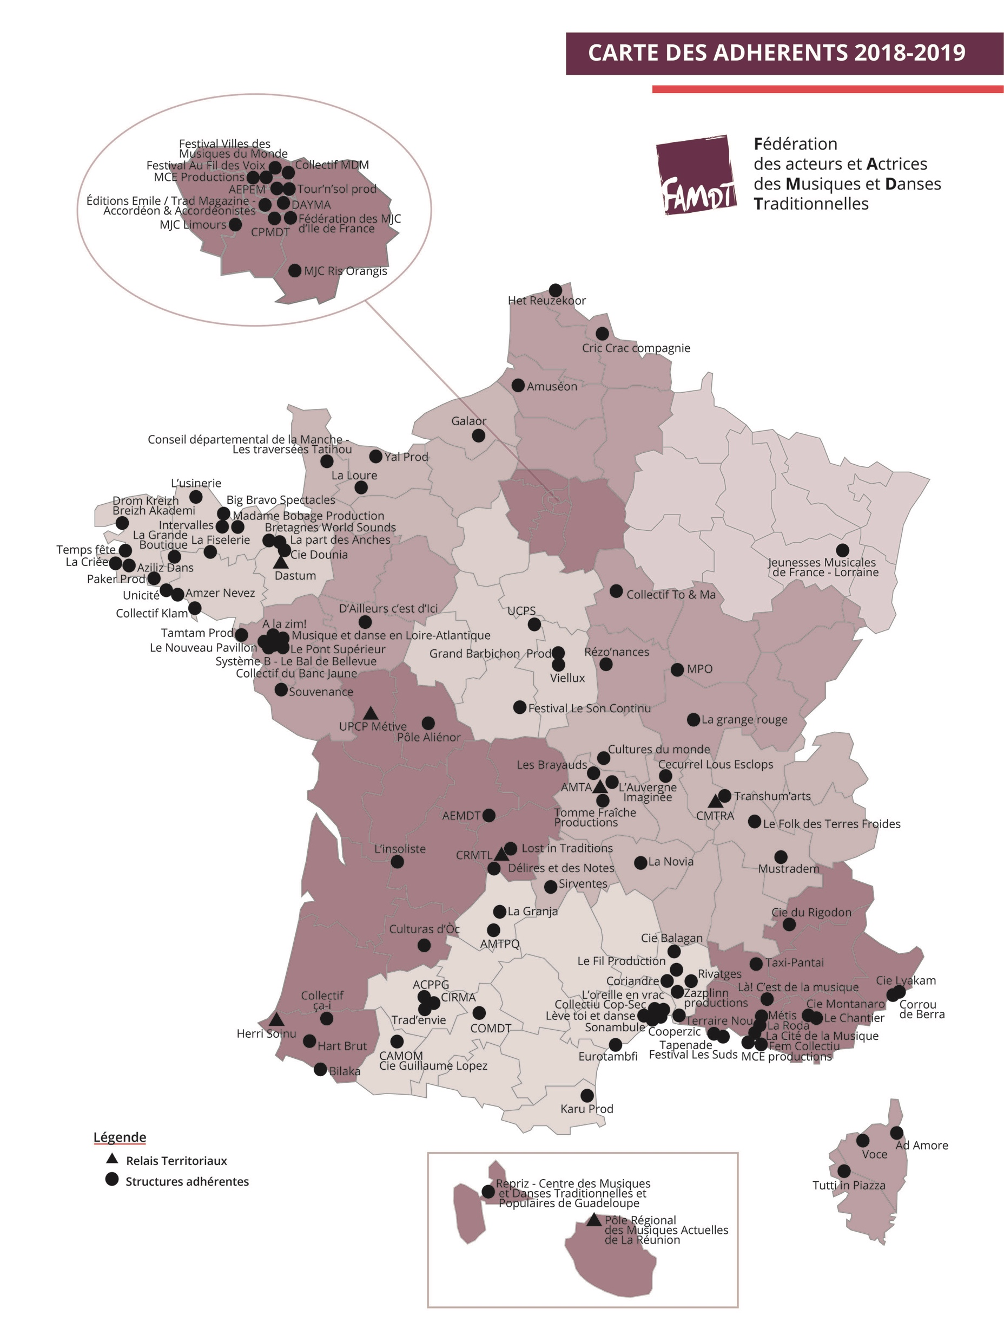
FAMDT: A NATIONAL and REGIONAL LANDSCAPE

Slide 4
TYPOLOGIES OF FAMDT'S MEMBERS
Places of creation and live music venues of the folk and world music / dance (Nouveau Pavillon, Le Chantier, Grande Boutique, le Sonambule, Amzer Nevez...)
Multi-activity and/or multi-disciplinary venues (Artistic factory space / cultural third-party venues);
Regional music and dance centres (AMTA - PCI, collection, creation)
Teaching places (music schools, higher education centres, etc.)
Festivals / event organisers (amateur and professional) (Fisel, Temps Fêtes, les Suds - Arles, Villes des Musiques du Monde etc)
Artistic collectives, artists, groups (Novia, Hart Brut, Cop-Sec, À la Zim...)
Producers/bookers/labels (Le fil Production, Pagans, Sirventes, Klam, L'Usinerie...)
Publishers (Dastum)
Cultural services or organisations working in the field of folk world music - dance (Agence départementale Musiques et danses en 44)
Local authorities (Manche department)
Music craftsmen (Lutherie)
THE MANAGEMENT METHODS ARE MAINLY ASSOCIATIVE (90%)
0

Slide 5
VALUES AND OPERATING PRINCIPLES
The positive affirmation of the diversity of a sector in strong dynamics, carrying the values of respect and emancipation of people, of living together and cultural sharing, of involvement and citizen initiatives
A corpus of shared values around cultural rights, intangible cultural heritage, popular education and the solidarity economy
An open vision of the field of folk and world music and dance
The will to include all the actors of folk and world music who could and/or would like to join a cooperation process
Taking into account a cultural diversity based on the involvement of people and the recognition of territories
Not a lobby but a space for co-construction of the general interest
Non-restrictive national entry to think and act at other territorial levels in support of the dynamics of the agents

Slide 6
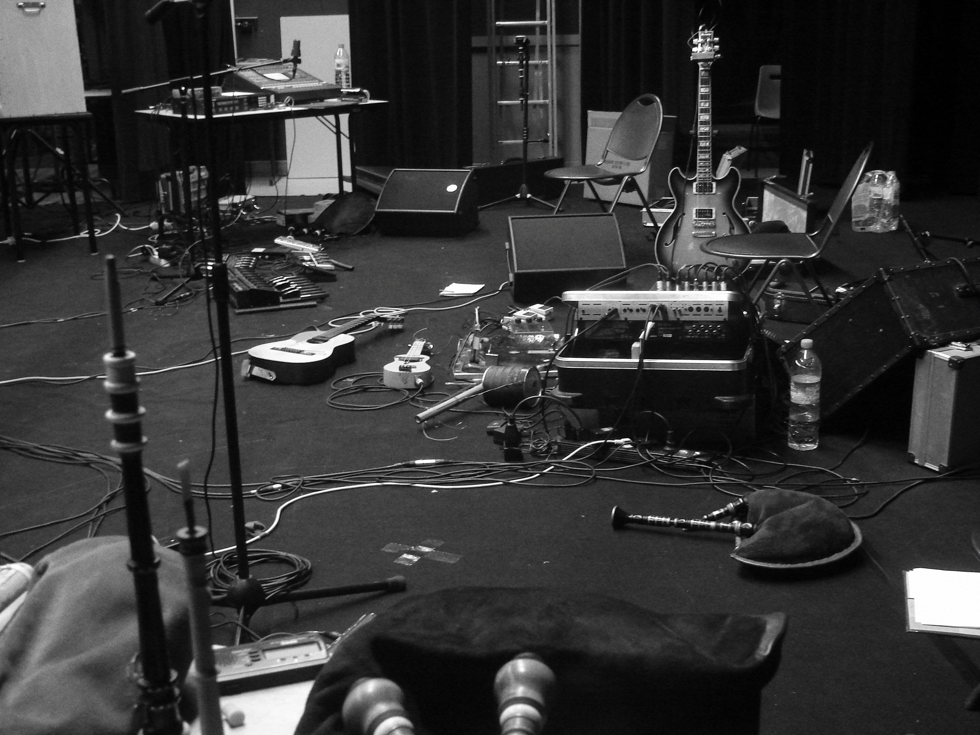
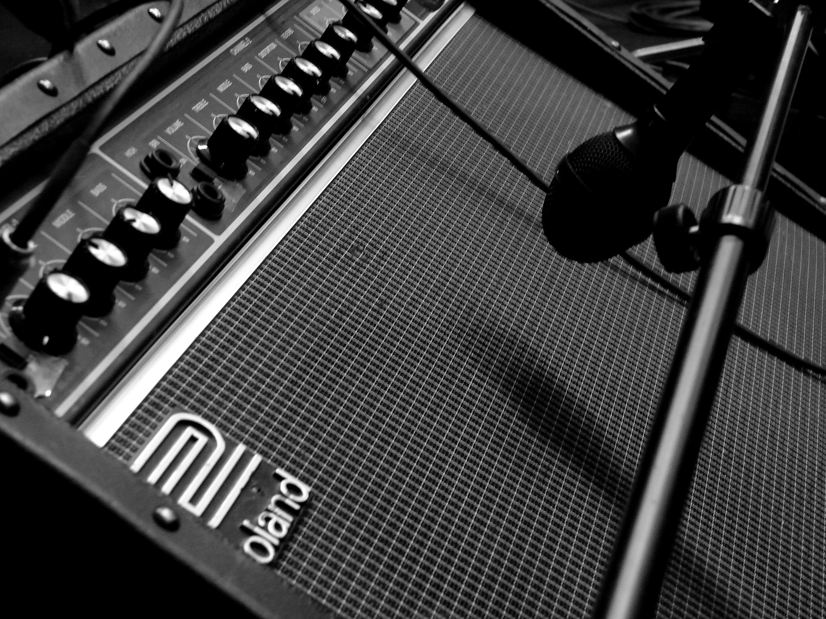
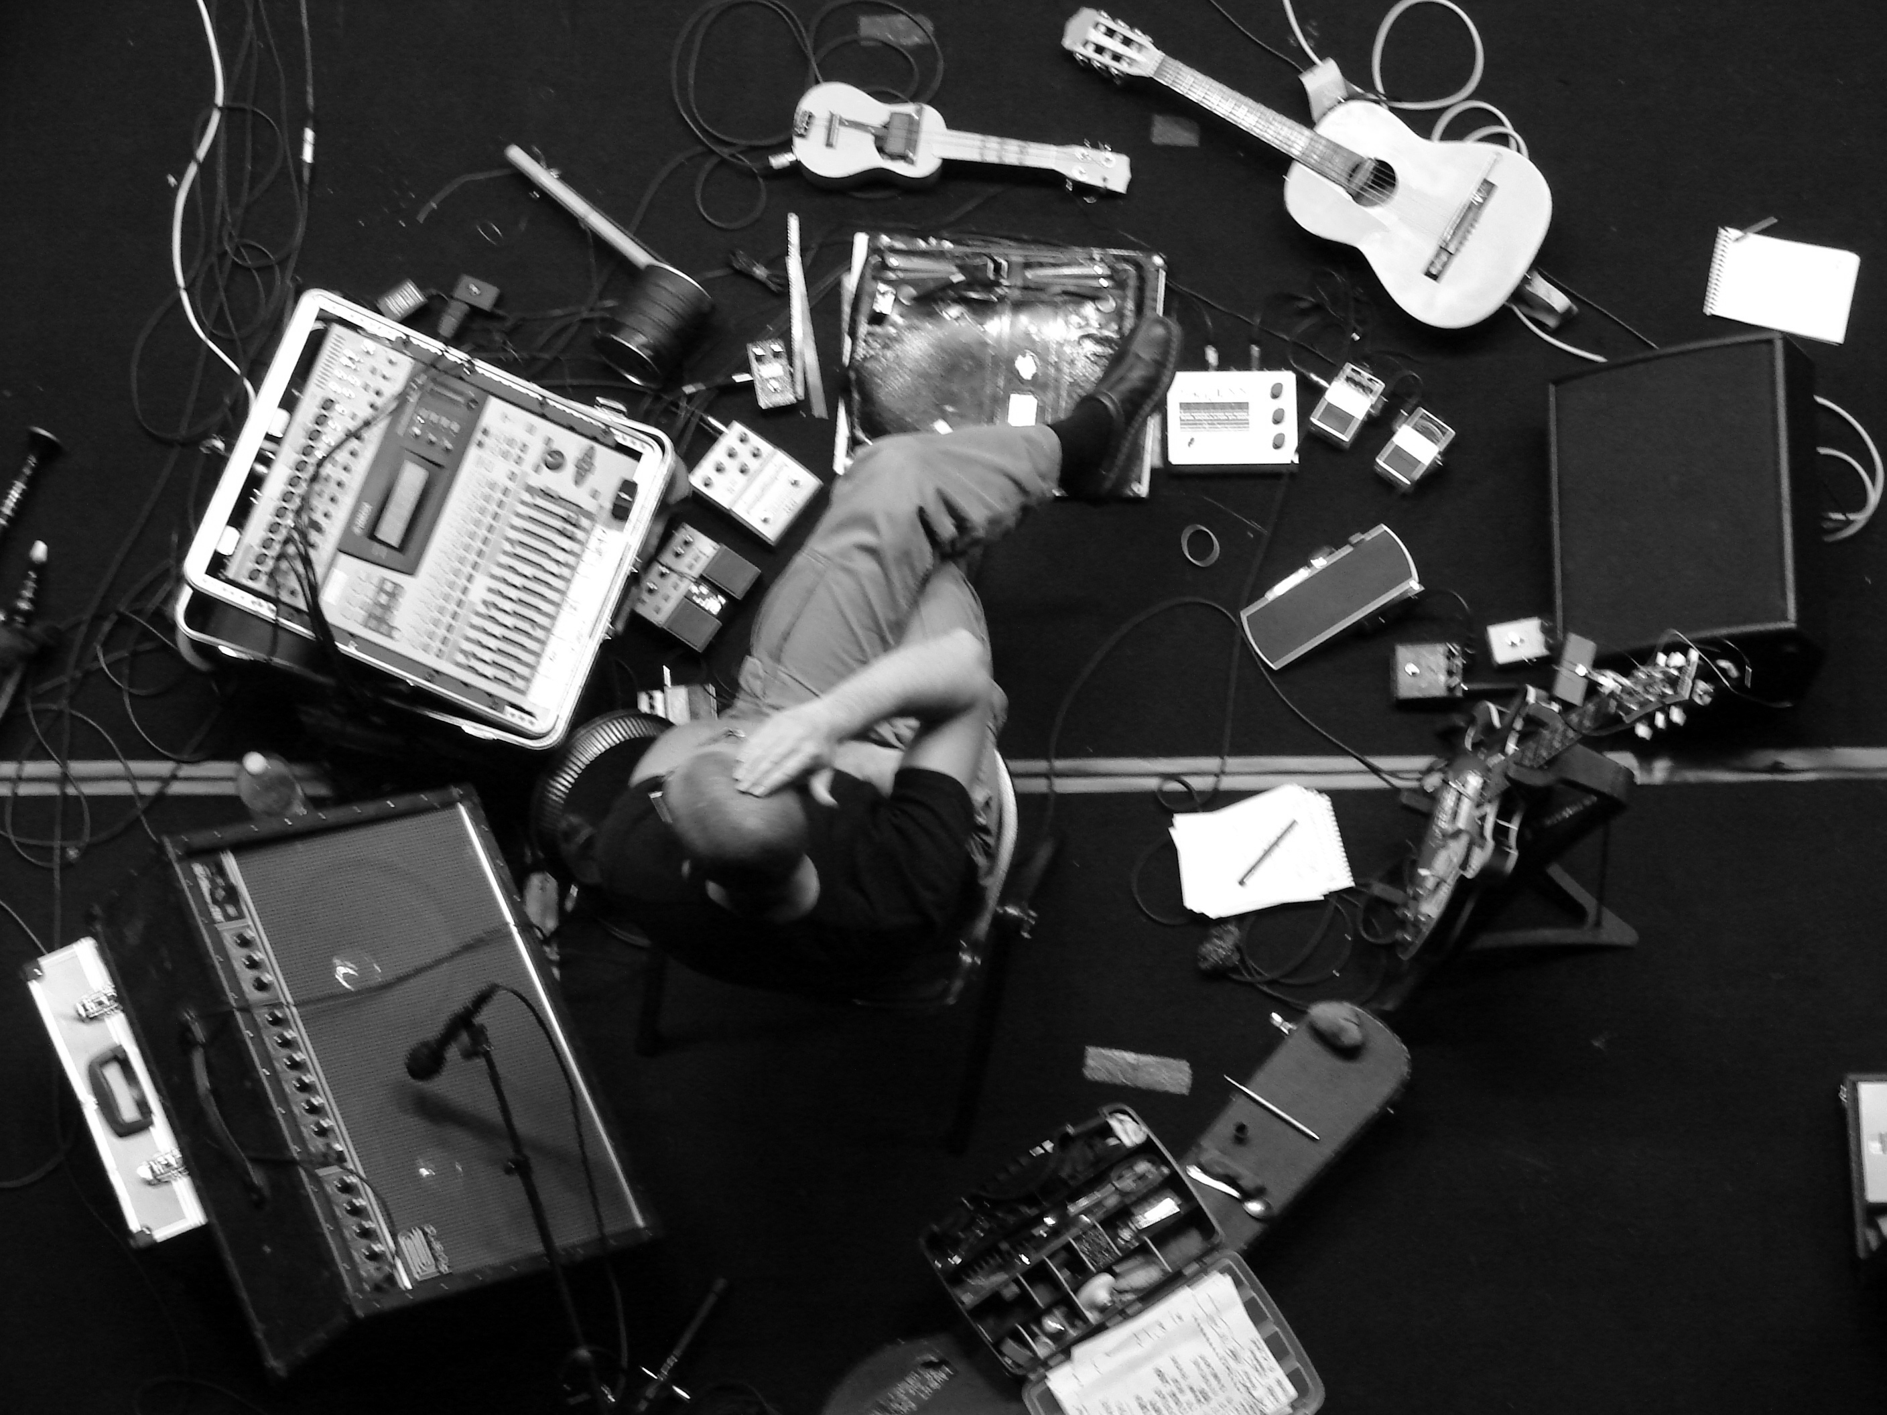
OUR ACTIONS
Transmission, training and support for professionalization: Companionship grants etc;
Live performance acts and creation: partnerships, co-production, inter-network dynamics, support, etc.
Documentation and the federation's heritage policy: BNF partnership (national library), management of the oral heritage portal, project for a portal on oral music and culture, etc.
Contribution to public policies in favour of traditional and world music and dance and the general interest in culture;
Involvement in working groups at the national level: regulatory and professional developments, work on the reality of practices and professions, amateur practices, National Centre for Music, etc;
Participatory and shared observation: The participative and shared observation: inventory of members, work on interprofessional dialogue and the co-construction of public policies;
A resource space and the federation's professional meetings;
The territorial issue with the creation of a network of territorial relays, an attention and support for collective structuring dynamics in the territories as well as exploration of the European and international field (European Folk network alliances...);

Slide 7
ORGANIZATION
A management team at the service of the federal project
A representation by territories with referent persons
A collegial organisation composed of 24 administrators
A support from the Ministry of Culture for our general interest missions: resources, networking, support for members, voice, etc
Not a lobby but a space for co-construction of the general interest

